Slide 1
Beta estimation

Slide 2
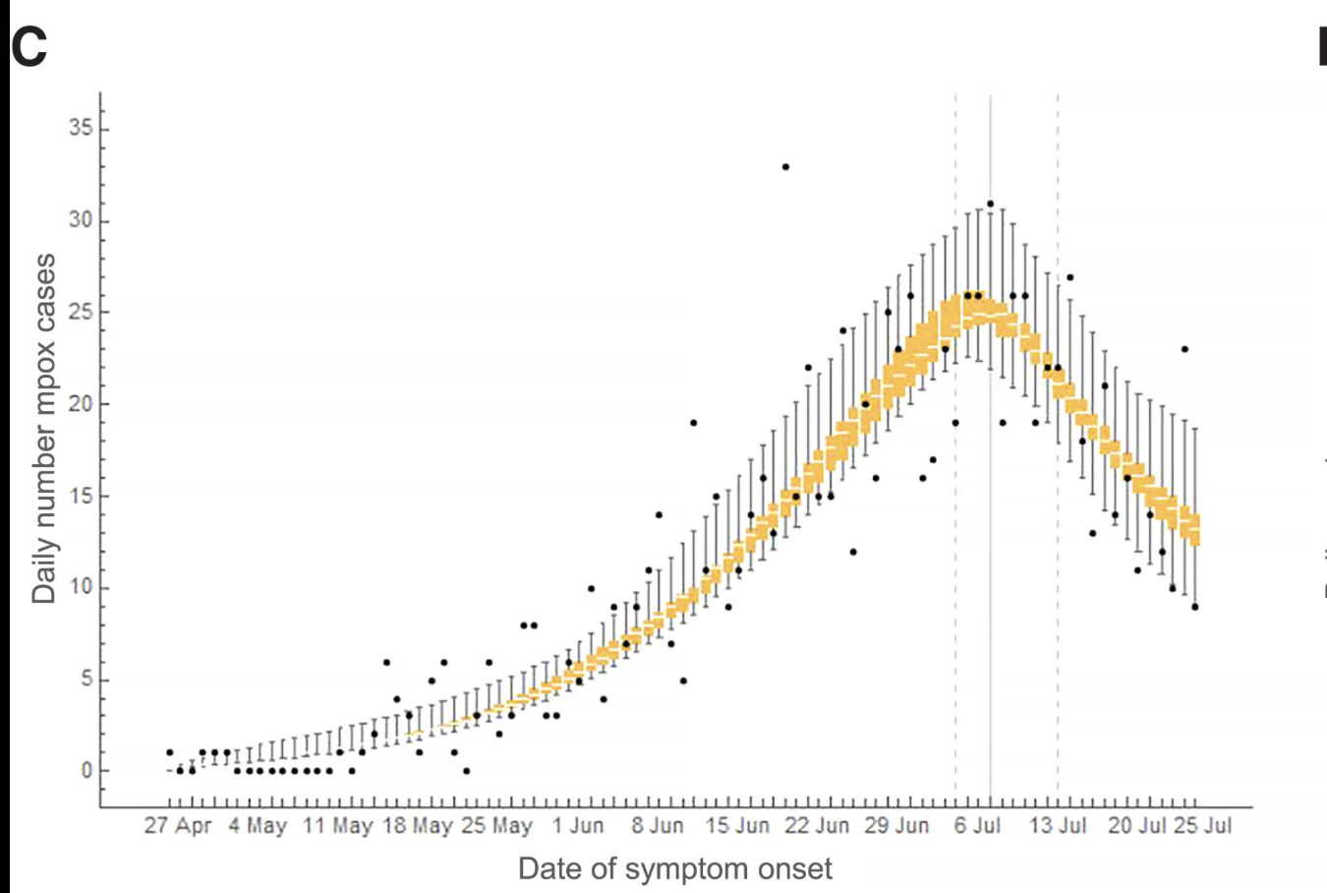
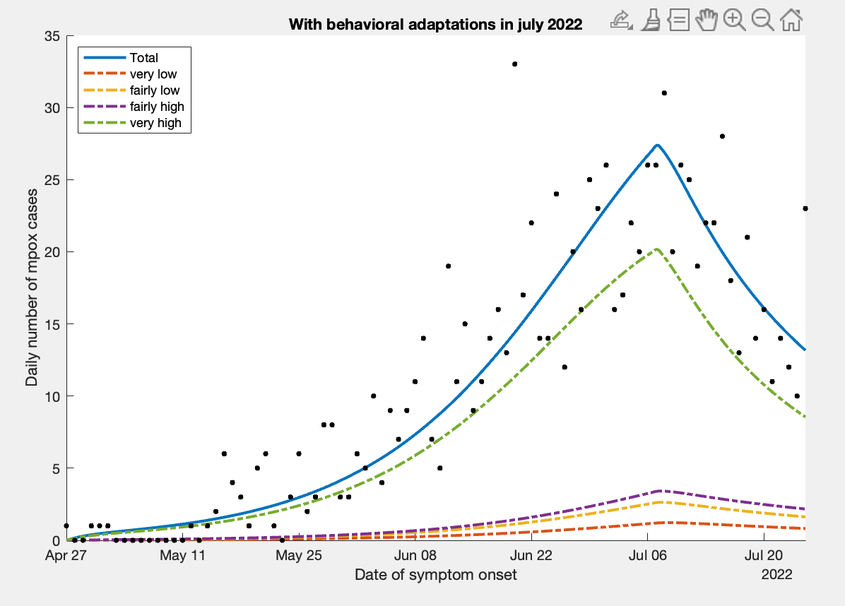

Slide 3
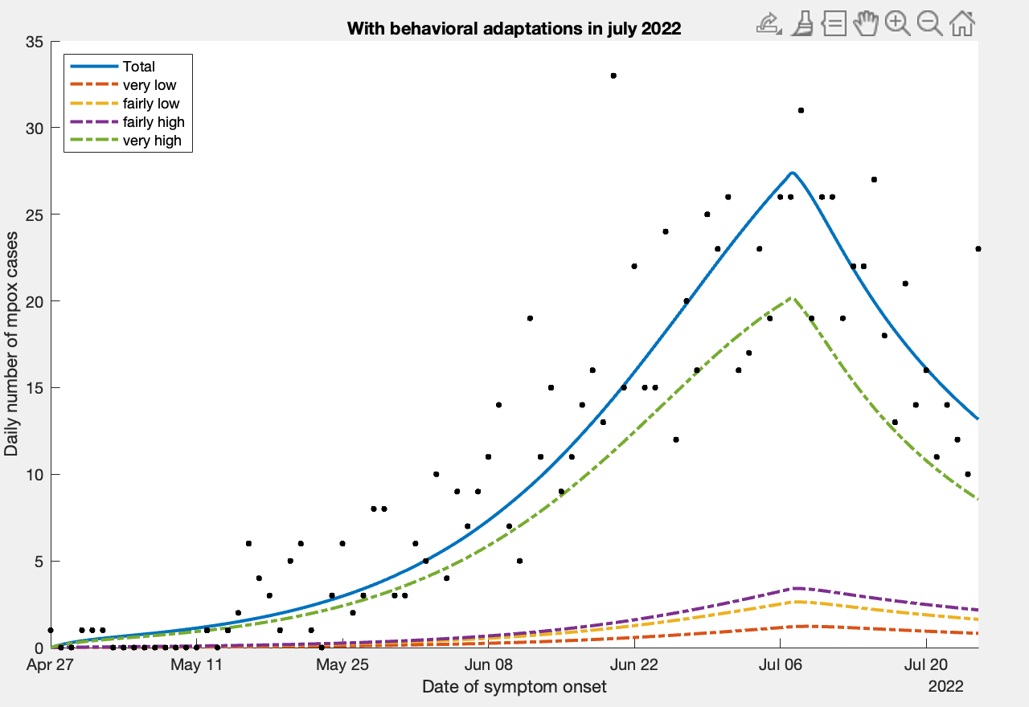

Slide 4
Initial Estimate
_______ ________
Beta 0.5 0.43784
Cost 7758.9 1373.4
Time NaN 0.56742

